Slide 1
NHS 111– lessons from the pilots and where are we now
Janette Turner
ScHARR, University of Sheffield
This independent commissioned and funded by the Policy Research Programme in the Department of Health. The views expressed are not necessarily those of the Department.

Slide 2
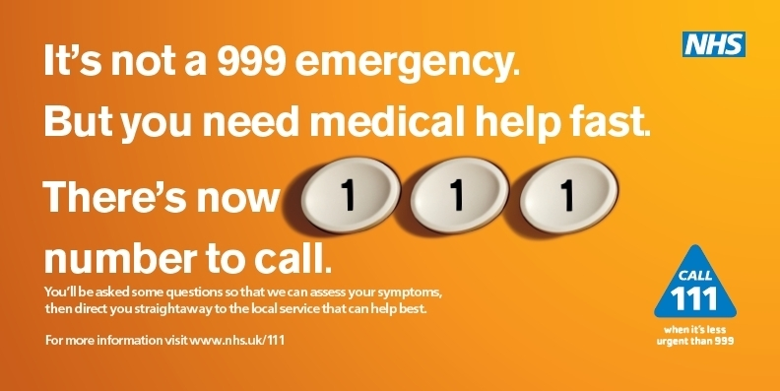

Slide 3
What problems is it trying to fix?

Slide 4
NHS 111
24 hour access to telephone advice for non-emergency health care
Non-clinical call handlers with NHS Pathways, with nurse advisors for some calls
Direct dispatch of 999 ambulance
Appointments made with some services

Slide 5
1. Improve access for patients
Reduce confusion by offering easy access to advice and direction
Free
Easy to remember number
Quick
(Direction of Travel; Darzi High Quality Care for All; DH press release Dec 2009; DH FAQ Dec 2009)

Slide 6
2. Expected benefits
Easier access
Increased efficiency (right place, first time)*
Increased public satisfaction and confidence in urgent care
Reducing non-emergency calls to 999 as long term benefit *
* “patients use less expensive services where appropriate”
(DH FAQ Dec 2009)

Slide 7
Will it fix these problems? Theory
NHS Direct
Advice and direction
08454647
Nurse
Wait
Assessment length
Separate
Software
NHS 111
Direction and advice
111
Lay operator
No wait
Shorter assessment
Integrated
NHS Pathways

Slide 8
Design: Mixed methods evaluation
Processes
Routine data on activity and quality standards
Postal survey of NHS 111 users 3m,9m (n=1200 per pilot)
Expert panel (n=55 calls)
Stakeholder interviews (n=22)
Outcomes: controlled before and after study
Population survey to assess perceptions (n=2000 per pilot)
Routine data on use of key services
Economics
Cost consequence analysis

Slide 9
Pilots
Durham & Darlington
Nottingham City
Lincolnshire
Luton
1 ambulance, 3 NHS Direct providers
Direct dial and OOH switch
Warm transfer OOH GP x3, urgent care x1

Slide 11
Did people get a good service?
Routine data
Low call abandonment rate (<0.5%)
Most calls answered in 60 secs (98.5%)
Low call back rate (5%)
2. Stakeholders
Working as planned with room for improvement and plans for expansion
Key is DoS and getting care pathways right, clinical engagement, electronic links

Slide 12
Users
65% very helpful advice
73% very satisfied
85% thought it had enabled them to contact “right service first time
86% complied with advice given

Slide 13
Strongly agree

Slide 14
Right place first time?
2% (36/1769) had an emergency service of 999 or ED late in their pathway
34/522 ‘problem calls’ from user perspective
8/34 problematic disposition
5 too high (4 had 999 ambulance)
3 too low
Post surgery, children, repeat calls, district nursing, analgesia, irrelevant questions

Slide 15
Impact on perceptions of access: urgent care users

Slide 16
More efficient?
Time series regression analysis 2 years before & 1 year after NHS 111 introduced
Ambulance calls & incidents
Emergency Departments
Urgent services (GP OOH, MIU, WIC)
NHS Direct

Slide 17
Overall trends
Significant impact on NHS Direct (reduction) and ambulance incidents (increase) in some sites
Trend towards lower ED and higher primary care but not big shifts
Impact variable according to site
Noise in the system – other initiatives

Slide 18
Change in system activity

Slide 19
Change is system activity
Service activity | Estimated change in monthly activity per 1000 triaged NHS 111 calls | Pilot v Control model – estimated % change in monthly activity (95%CI)
ED attendances | -1 (-66, +64) fewer attendances | -0.1% (-3.8%, +3.7%)
GPOOH, WiC, UCC. MIU attendances | +47 (-66, +159) extra attendances | +2.5% (-3.5%, +8.5%)
Calls to NHS Direct | -102 (-130, -74) fewer calls | -19.3% (-24.6%, -14.0%)
Calls to 999 ambulance service | +3 (-31, +37) more calls | +0.3% (-3.1%,+3.7)
Ambulance 999 incidents | +24 (+8, +39) more incidents | +2.9% (+1.0%,+4.8%)

Slide 20
3% increase in ambulance incidents
24,000 extra incidents per million NHS 111 calls
15,000 extra incidents for a service currently responding to 500,000 incidents per year
180,000 extra incidents above current 6 million

Slide 21
Why little impact? (perceptions of access and system use)
Small dose
Too soon
More integration to occur
Insensitive measures
A lot of “noise”
Little impact

Slide 22
How has it progressed?
 | September 2011 (4 sites) | February 2013 (18 sites)
Population | 1,822,600 | 11,335,065
Calls offered | 33523 | 218114
Abandoned | 0.4% | 3.2%
Answered within 60 secs | 98.4% | 90.4%
Clinical Advice | 27% | 27.5%
Warm transfer | 95% | 72.5%
Callbacks Within 10 minutes | 5% 64% | 27% 53.4

Slide 23
System effects – compared to previous year
 | September 2011 | October 2012
ED attendances | -646 (-4.6%) | -1108 (-0.9%)
Urgent/primary care contacts | -419 (-3.2%) | -2588 (-1.8%)
Calls to NHS Direct 0845 | -1098 (-31.2%) | -8049 (-29.3%)
Ambulances arriving on scene | +460 (+9.1%) | +5242 (+8.5%)
Ambulances triggered by 111 | 3126 (15%) | 9198 (13.8%)
111 triggered transported | 2316 (76.3%) | 6750 (73.3%)

Slide 26
So what’s happened?
Relatively stable up until recently
14 additional sites live by February
Some local issues identified
Limited adverse publicity
High user satisfaction

Slide 27
Delays, abandoned calls and an 11-hour wait for a call-back: Leaked document reveals the extent of NHS 111 performance issues
NHS 111 in 'total meltdown
Inquiry into failings in NHS emergency care

Slide 28
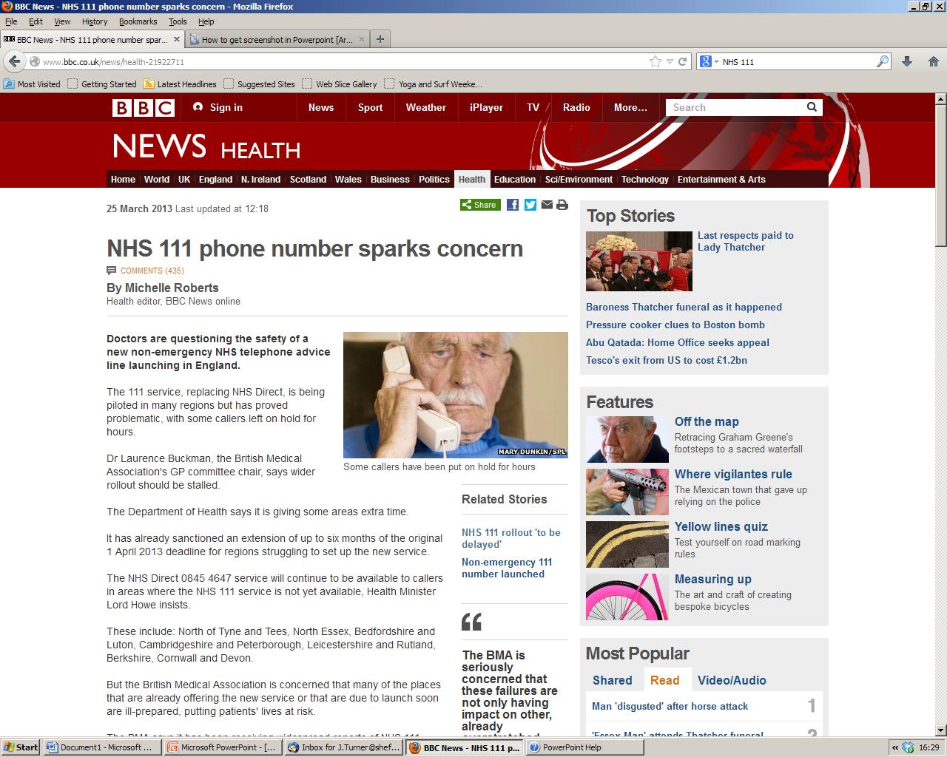

Slide 30
Improvements & Challenges identified in pilot evaluation
Relevance of questions
Ambulance use – understand increase
Integration – Pathways & DoS
Dealing with increased demand
NHS Direct closure – different case mix

Slide 31
Possible causes - Time
Planning service & procurement
New models
Developing and agreeing pathways
DoS
Staff recruitment and training
Technology testing
Commitment
Not resolving early issues first

Slide 32
What we need to understand
Appropriateness of 999 dispositions and how to manage this
Impact of turning off 0845 – monitor call volumes and accurately estimate activity
Changes in demand for urgent & emergency care underlying this
Who is accessing the service
Rigorously assess real impact of introduction

Slide 33
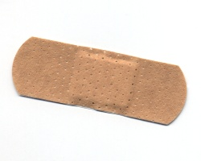
Salvageable or not ?

