Slide 1
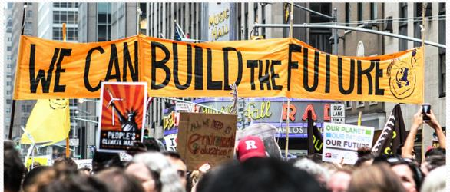
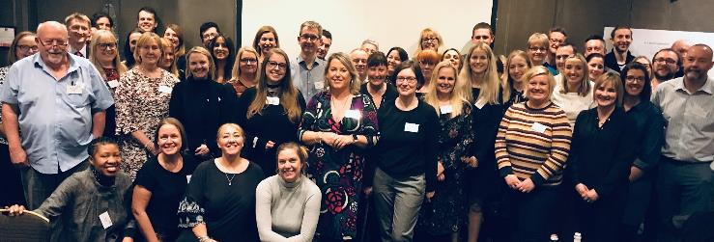

Culture and Leadership Network for Ambulance Services
Culture Conference 2020

Slide 2
The purpose of this report
What we are trying to achieve:
Collecting inputs and outputs from the day
Making a record of what happened on the day and the energy in the room
Documenting the wealth of information and experience that the attendees bring
Providing the presenters slides with some attached comment.
We are not trying to do:
Making verbatim notes
Analysing or prioritising ideas
Developing a decision document or a fully agreed action plan
Report compiled by Ian Baines and Kathryn Perera NHS Horizons

Slide 3
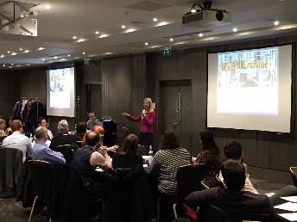

Kathryn welcomed all to the day……
“Unless we are all present then no-one is present”.
Notes:
Andy Bradley introduce himself

Slide 4
Time | Our agenda for the day
10.00 – 10.15 | Welcome and introduction to the day Kathryn Perera and Claus Madsen
10.15-10.45 | North East Ambulance Service NHS Foundation Trust Gemma Knight and Helen Ray
10.45-11.35 | Mersey Care NHS Foundation Trust Amanda Oates
11.35-11.50 | Refreshments
11.50-12.30 | Hull University Teaching Hospitals, NHS Trust Simon Nearney and Miles Howell
12.30-12.45 | Planning our ‘Unconference’
12.45-14.00 | Lunch provided Networking and discussion around poster/roll-up displays: Ambulance Trusts showcasing work that we are proud of around Culture
14.00-15.10 | Unconference An ‘open space’ event in which participants design the agenda (based on the morning’s discussions) and convene conversations on a range of themes
15.10-15.45 | Moving to action Facilitated activities to agree next steps and commitments to act
15.45-16.00 | Closing and thanks A “snowstorm” of feedback to close our event
16.00 | Close

Slide 5

AMBULANCE
CULTURE CONFERENCE
CALNAS
Culture And Leadership Network
for Ambulance Services
17 January 2020
Claus Madsen, AD of Education and OD, Yorkshire Ambulance Service / Chair of CALNAS

Slide 6
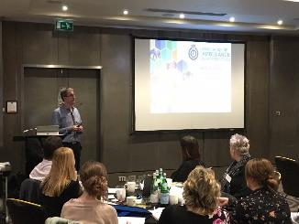
“Through the AACE Human Resource Directors group – We were asked to work through at a national level where we could make a difference to our culture..
Locally we are all doing exciting stuff and want to improve the staff survey results. Lets inspire each other and take the opportunity to drive our work at a national level”.

Slide 7
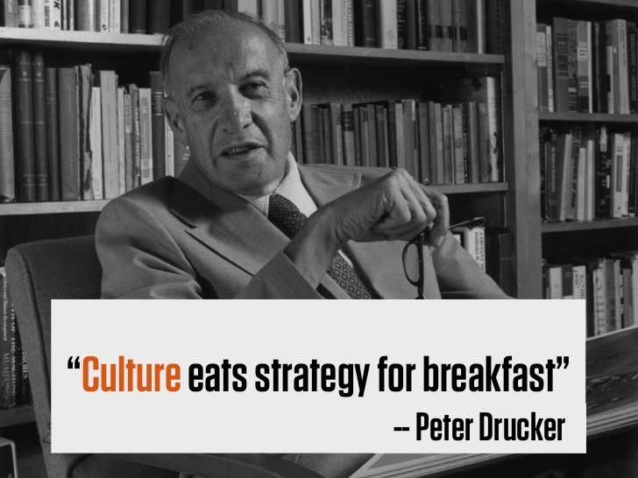

Slide 8

Concept for today
Inspirational presentations
  NEAS
  Mersey Care NHS FT
  Hull University Teaching Hospitals NHS Trust
Cross-fertilisation and networking
  Posters/roll-ups, sharing what we are proud of, completed initiatives or journeys
  Getting tangible ideas from each other
Facilitated solutions-focussed sessions
  ‘Unconference’ / open space sessions
  Co-creating tangible ideas and identifying potential initiatives
  National as well as local
“Lets have the conversations today – mingle, talk – inspire each other”.
“Let’s be solutions focused”.

Slide 9
Background
Ambulance Leadership Masterclass, May 2018
  Hosted by NHSI and attended by most Ambulance Trusts
  Discussions around more joint working on Culture, Leadership, OD agenda
CALNAS developed/established with NHSI and AIP support; Q2+Q3 2018
  AACE approval Oct 2018
  Scope / work programme agreed by HRD group Dec 2018 and membership nominations
First meeting in February 2019
Drivers for the CALNAS work programme:
  AACE strategic priorities
  Ambulance Improvement Programme
  Carter recommendations
Headlines for CALNAS’ Culture & Leadership work programme:
  Culture Conference – with NHSI; develop and host
  Culture Index
  Leadership benchmark / evaluation
  Leadership Capacity and Capability
  Talent Development
  Staff Engagement – especially around ‘hard to reach’ staff
  OD support / Capabilities
“If we move from average to good on our engagement – the evidence points to a 5% reduction in mortality for patients”.
“We really want your input and ideas to our national work programme”.

Slide 10
Organisation
AACE
HRD
NENAS
CALNAS
AIP

Slide 11

From AACE’s
Strategic Priorities
Main focus:
Number 3: Strive to be an employer of choice
  Develop and enhance the ambulance service culture
To also underpin further AACE priorities, especially…
Number 6: Promote the reputation of the sector …
  Optimise the benefits to the sector of national programmes (link to joint AIP)
  “Be stronger together” – utilise synergies
“Let’s be an employer that engages and looks after our people.”

Slide 12
Carter recommendations
1. LEADERSHIP: Encourage leadership at all levels a. Line managers’ performing compassionate, engaging and empowering leadership b. All staff to demonstrate and role-model organisational values and behaviours c. Understand reasons for leaving and improve retention accordingly in terms of ‘leadership’ and/or ‘engagement’ issues
2. ENGAGEMENT: Improve staff engagement a. Including sector-wide learning through sharing of best practice
3. APPRAISALS: Ensure all staff have an annual performance review of an aligned high quality standard a. “Standardisation” = approach to pay progression, key components of appraisal, compliance recording, quality measures (via NSS)
4. CULTURE: Develop and embed a supportive, appreciative and enabling Culture with equal opportunities for all and where everyone is treated with dignity and respect in a zero tolerance environment with regards to violence, bullying and harassment

Slide 13
Purpose of CALNAS
The purpose of the national Culture and Leadership Network for Ambulance Services (CALNAS) is to ensure an aligned national approach to a positive change in culture and improvement in the effectiveness and impact of outstanding people leadership in the sector.
The ambulance culture needs to move from a blame culture with a lack of consistent accountable leadership (i.e. evidenced through low scores on leadership and engagement questions in the National Staff Survey) to a ‘just culture’ that promotes learning, quality improvement, inclusivity and leadership that is compassionate, collaborative, engaging and empowering.
The CALNAS network will identify and enable mutual synergies, efficiencies, productivity and quality improvement gains through cross-fertilisation of ideas, shared learnings, collaboration on developing new concepts and co-procurement of external provision of leadership and organisational development

Slide 14
Next Steps
We will take an Oxo cube of feedback and make it into a soup of the key points today.
Each Ambulance Trust
  To take away ideas and actions for local consideration and implementation
NHSI/Horizons/CALNAS
  From this conference – share on national sites (NHSI / AACE)
  Summarize key points and ideas and bring to AACE’s “Ambulance Leadership Forum” (ALF) in March 2020 to engage senior leaders on this
CALNAS via HRD group
  Post-ALF define how this informs existing national workstreams as well as identifying further national workstreams
  Lead on and monitor progress on national workstreams and national benchmarking across the sector

Slide 15
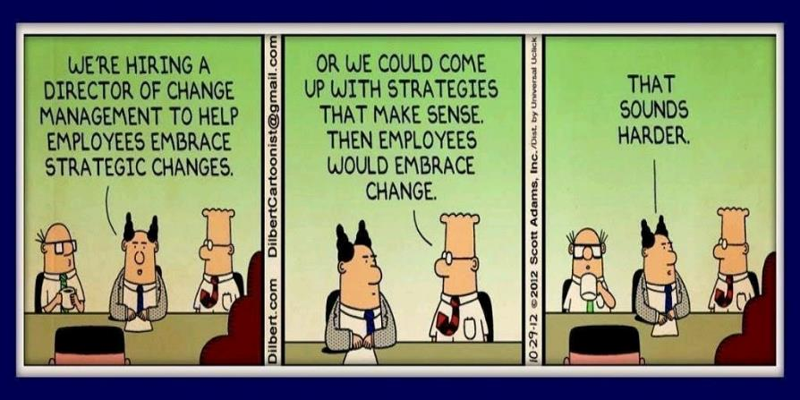

Slide 16


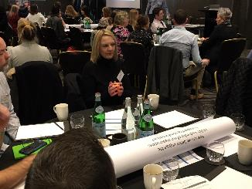
First conversations
We asked people to start their conversations…….
On your tables are some dice
Introduce yourself to your neighbour, roll the dice and answer the question that corresponds to the number on the dice
Interpret the question you get for your own experience / context
1 - One thing I want to explore today.
2 - The reason I choose to do the work I do.
3 - One thing I would like to change about the Ambulance Services.
4 - A little known fact about our local services.
5 - If I had a magic wand, our culture would be…
6 - One thing we do to build a positive culture
that I think others could benefit from.

Slide 17

Our morning sessions
A collection of deep-dives on culture work happening across the NHS
An opportunity to reflect and discuss our learning
Preparing us for creating our own agenda for this afternoon
Each presentation now follows with some quotes from the presenters and one or two photographs……………..

Slide 18
CALNAS Conference January 2020 London
Growing a Compassionate Culture:
Bringing Our Values to Life
Helen Ray, Chief Executive
Gemma Knight, Strategic Organisational Development Manager

Slide 19
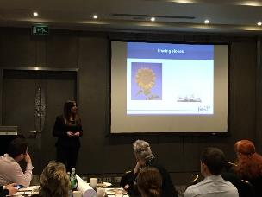

Sharing stories
Hans Schiffer, on growing the tallest sunflowers in the world –”I take pure joy from seeing something flourish”. This spoke to us.
We had some powerful stories that we needed to start sharing.

Slide 20
Sharing our story
We are the North East Ambulance NHS Foundation Trust
We embarked upon a cultural change
Employees told us improvement was needed
Our culture was not as effective or supportive as it could be

Slide 21
In the beginning…
Our journey began in 2014
Revised our approach to change
Not a quick fix
True change – Rooted in compassion
Very proud to say that we have achieved that change
Growing a Compassionate Culture

Slide 22
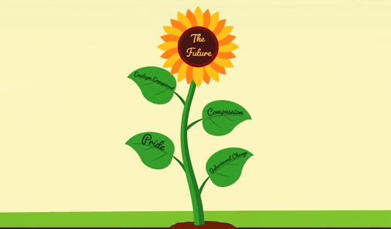
Our film…growing a compassionate culture
Please click on the link below and insert the password to watch our film on culture change.
NEAS Growing a Compassionate Culture on Vimeo
Password is neas555

Slide 23
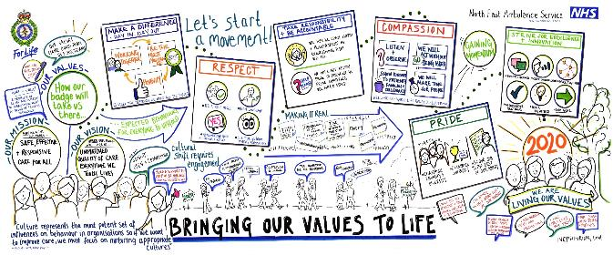
‘Bringing Our Values to Life’
As many employees as we could to make this event – it needed to feel different……..small changes were essential. Agreed our journey – 5 years and commit to it.
We didn’t create these behaviours – our employees did – brave as we needed to champion. The visual and embedded into everything.

Slide 24

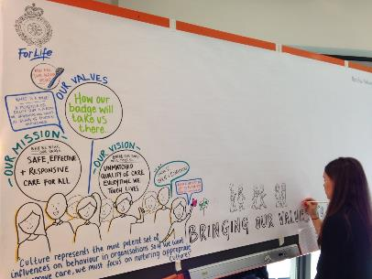
‘Bringing Our Values to Life’
Created ‘Our Behaviours’ collaboratively
Grown a coaching culture
1-1’s/ Appraisal ‘Let’s Talk About You’
Management and leadership
Personal development
Occupational Health
Equality and diversity
Bespoke team development
Woven into all we do

Slide 25
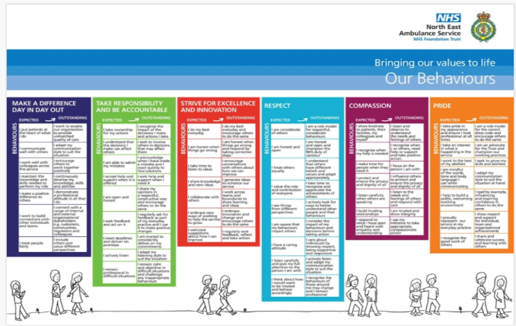
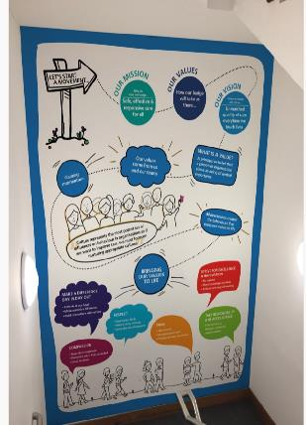
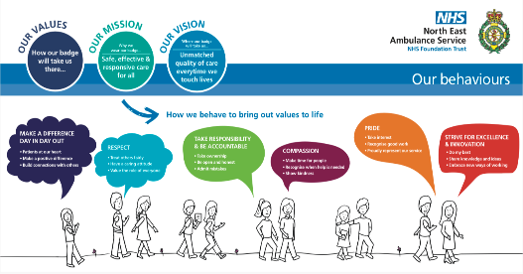


This isn’t a fad – this is who we are!!!

Slide 26
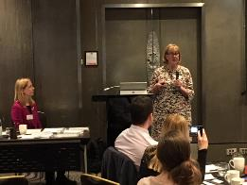
Results Indicator
Staff Survey Results: Positive trajectory
Yes we have good things but we need to face into our challenges.
The NEAS culture speaks to me ……..I did my due diligence.
“Management is transactional and keeps us safe. Leadership is emotional, it is how we make people feel. There is nothing more powerful than making staff feel valued and safe in their roles”. Helen Ray (Chief Executive)

Slide 27
Sickness Absence %

Slide 28

Culture change doesn’t stop
Where to next?
In my first 100 days I feel we are on track but I want feedback from all our teams and then we’ll use it to shape our culture into the future.

Slide 29

Interactive Session Space
Share stories ~ Experience ~ Thoughts ~ Ideas ~ What If’s
How can we better engage the middle leadership of our organisation’s in supporting transformation?
Make sure middle managers ger released to things like today – where is the operational management in the room today? Releasing staff is an issue. Josh
Empowerment and accountability – let the middle management team have the support to deliver the changes we want. Rob
Do people know where the boundaries are between leadership and management? Support and training needs to go across not just vertical. Nicki

Slide 31
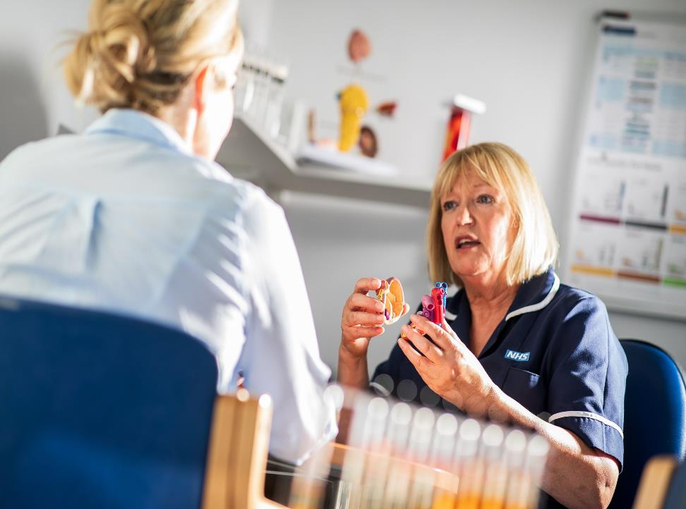

Creating a Just Culture
‘…..when it is ok to tell the boss bad news…..’
Amanda Oates– Executive Director of Workforce
Mersey Care NHS Foundation Trust
@amandajoyoates
© Mersey Care NHS Foundation Trust

Slide 32










Welcome to Mersey Care
Notes:
We started out as a mental health trust defined primarily by our high secure hospital at Ashworth, and have grown in recent years to provide the full range of mental health, learning disabilities and addictions services, along with community services in our core geographies of Liverpool and Sefton.
Our changing shape as an organisation has always been driven by our understanding of what the people that we serve need, and by our belief that our staff know how to meet that need.

Slide 33
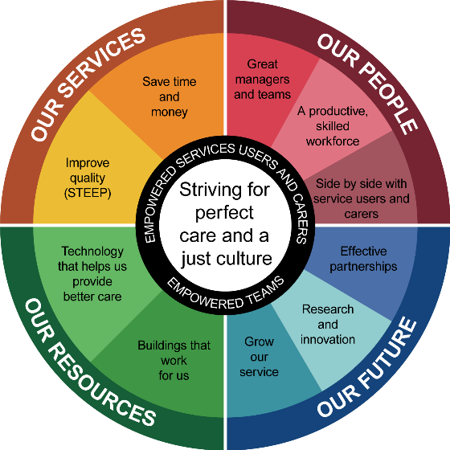
Through our direction – drive to quality is our total focus

Slide 34
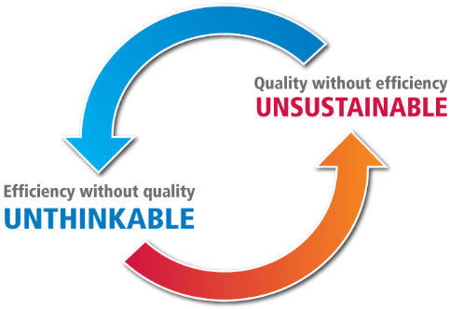
Through our direction – drive to quality is our total focus

Slide 35


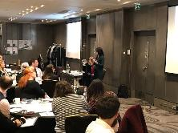
What is a Just Culture
A Just Culture
A just culture accepts nobody’s account as “true” or “right” and others wrong … Instead it accepts the value of multiple perspectives, and uses them to encourage both accountability and learning.
Sidney Dekker
There is no right answer – different professional lenses give different views…..

Slide 36
Retribution
Goals of restoration
We need learning – it helps move us to prevention and the patient safety space.
Which rule is broken
Who did it
How bad is the breach
What should the consequences be
But…it’s counterproductive
Be restorative…
Learning
Team
Review
Humanity
Compassion
Forgiveness
Understanding
Restoration
Healing
Trust
Who is hurt
What are their needs
Whose obligation is it to meet those
How do we involve the community
Moral engagement
Emotional healing
Reintegration of practitioner
Organisational learning
Prevention

Slide 37
Goals of restoration
Moral engagement
Emotional healing
Reintegration of practitioner
Organisational learning
Prevention

Slide 38

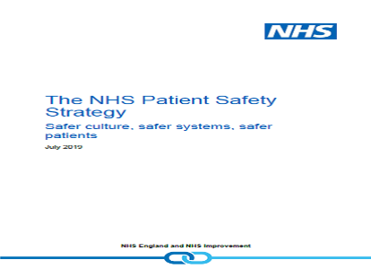

NHS Context
- Patient Safety Strategy &
Interim NHS People Plan
Continuous improve patient safety
Create a patient safety culture
Safety systems and processes

Slide 39

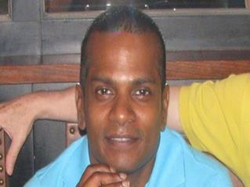
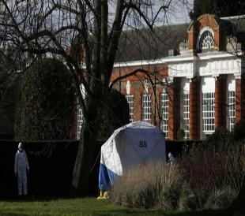
One NHS Reality
Amin Abdullah
Are we compassionate and do we support healing or do we move to investigation?
We should not let our people processes harm our people…
What is your Reality?
In asking the room to consider where their organisation was in relation to compassionate culture (10 excellent, 1 extremely poor) – the room indicated that most felt their organisations would rank between 4 and 6 with this simple scale.
Notes:
32 nurses in 17, 51 in 2016
This is Amin Abdullah a 41 year old Malaysian nurse who worked at Charing Cross Hospital. Amin along with 17 other co workers signed a petition in support of a colleague after a patient made a complaint about the colleague. He / they stated the patient was a "professional complainer against NHS staff“ He was suspended from duty for his actions. Mr Abdullah was charged with writing an "untrue letter" and not following the correct complaints procedure. He was dismissed for gross misconduct on 21 December 2015 – 2 days before Christmas
After slipping into severe depression, he admitted himself to St Charles Hospital. He was later allowed out to collect a change of clothes. Amin walked into Kensington Park, doused himself in petrol and set himself on fire. He died. This was two days before an appeal hearing regarding his dismissal.
An independent investigation was commissioned into the handling of his dismissal. The investigation found the trust's disciplinary procedures against Mr Abdullah were "weak and unfair". It found that the investigating officer failed to disclose evidence that was critical of her but showed Mr Abdullah being in the right, and that the investigating panel did not have al of the information needed available to them. Evidence submitted to the hearing panel did not paint "an honest and complete picture", the report said.
The report acknowledged that Abdullah’s signing of the petition and letter was “not appropriate” and “naive” but that there was “no evidence it was malicious”. Furthermore, The independent report also found that not only was Amin dismissed unfairly but none of the other 18 colleagues and signatories had been disciplined.
The independent investigators also criticised the fact that Abdullah was forced to endure a three-month delay in proceedings.

Slide 40


Why ? - Staff wanted a staff BHAG ….
…they wanted to work in a safe place, be treated fairly and compassionately, and so our
Just & Learning Culture was born….

Slide 41


Mersey Care’s Just and Learning Culture
Delivering our ambition for Perfect Care depends on the development of a non-punitive culture;
Learning can only flourish when responses to mistakes are compassionate;
Personal responsibility and professional accountability drives the organisational learning;
It’s not about 'blame-free' or being tolerant of absolutely anything;
It’s a careful balance of accountability and learning;
A prospective outlook rather than a retrospective bias;
Ask what and how, not who because a bad system will always beat a good person.
A Just Culture (from Sidney Dekker)
Brings out information about improvement to levels/groups able to do something about it;
Allows the organisation to invest in improvements that have a safety dividend, rather than deflecting them into legal defence and liability protection;
Simultaneously satisfies demands for accountability and the need to learn and improve.

Slide 42
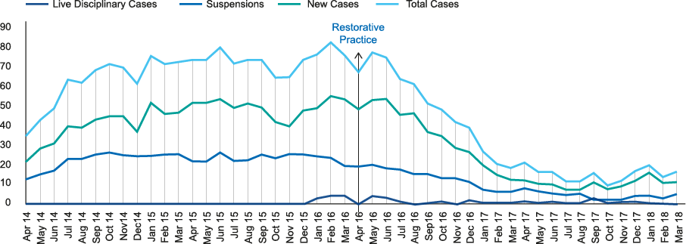
Just and Learning Culture
Just Culture the Movie – google it
Impact of restorative practice on live disciplinary cases and suspensions in local and secure divisions
54%
Reduction in disciplinary investigations in two years
£1.7m
Saved in clinical suspensions
in two years
= Safety dividend
Notes:
Message for both divisions particularly secure, the total number of cases is high re investigations at any one time, particularly stark in secure because of practices which where highly retributive , had led to a high number of employment tribunals and in one instance strike action.
KEY MESSAGE – trust wide over 2 years seen 54% reduction in investigations during same period workforce more than doubled

Slide 43

Disciplinary and Suspension Data
The graph below provides the decrease in disciplinary and suspension data since 2014
We estimate 6% of our workforce were under disciplinary in 2014
We still have disciplinary investigations but we hurt a lot less people.

Slide 44

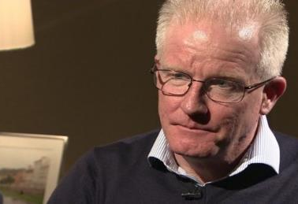


The real dividend is safer patients and staff
20
suicides avoided in three years
(Nov 2015 to Nov 2018)
166
staff suspensions avoided since January 2017
410
disciplinary investigations prevented since
January 2017

Slide 45

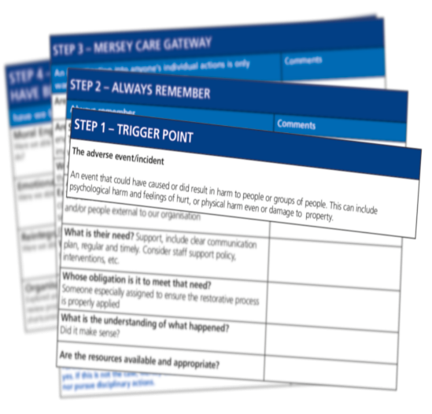
Our Just and Learning Culture has shaped how we have approached improvements in our people processes.

Slide 46

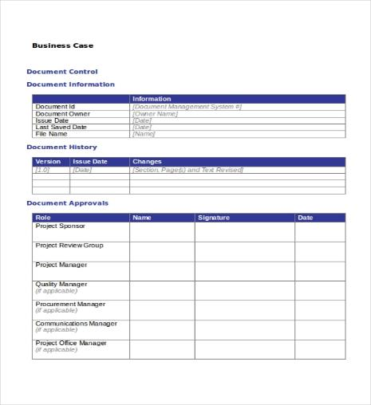
The Business Case

Slide 47
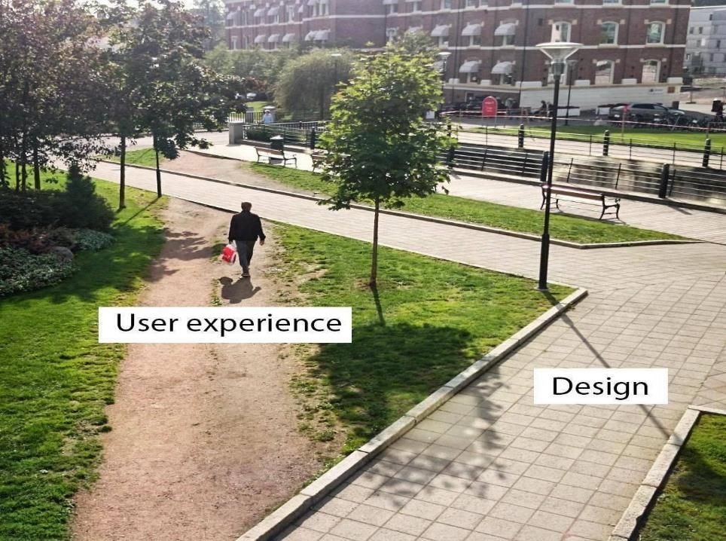

Work as imagined & work as designed
Do your policies enable or inhibit good care?
Notes:
We imagine that everyone follows the right path (yellow brick road) and follows operational procedures as they are designed and laid out as part of the policies and procedures framework.
When we think about HR and practitioners, Imagine that people work to the design and procedural framework set out on accordance with all p+p which no person would have the man hours to read and retain v the work that managers and practitioners …..99% of the time everything goes perfectly. Do we want to punish them for the one time that the staff member created that shortcut.
Work imagined v work done relate to policies and practices
Policies and practices to support practice or polices and practices that punish
Rule based focus on the design, restoratively focused – focus on how work is done – think about routine surprises

Slide 48

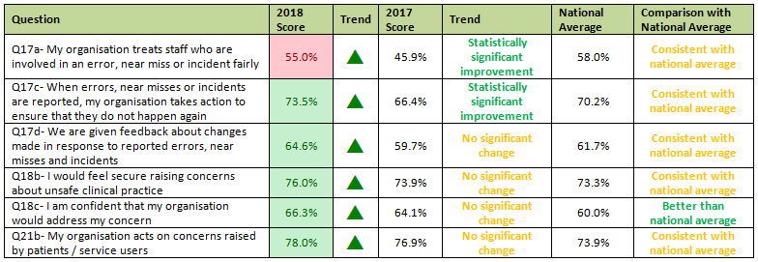
Value Creation 2018 Breakthroughs
2018 Staff Survey Results – Safety Culture
Overall staff culture theme 6.9 against an national average of 6.8
* In our community division following acquisition on 1st April 2018 (post Kirkup enquiry) 10% improvement

Slide 49

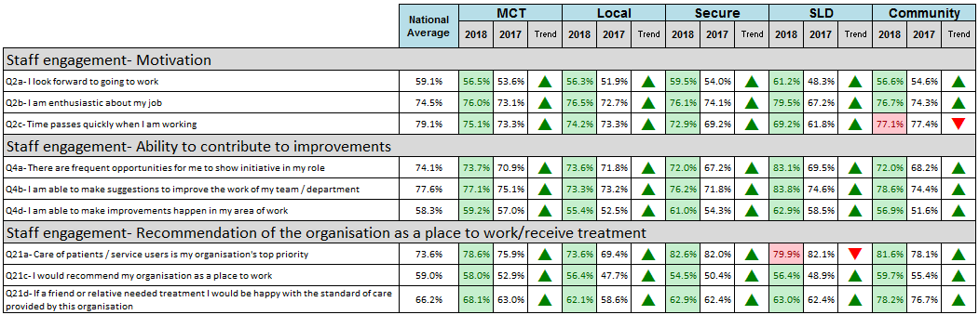
Overall Staff Engagement
2017 – 2018 Comparison
Meeting or exceeding National Average
Below National Average
Overall Engagement Score

Slide 50

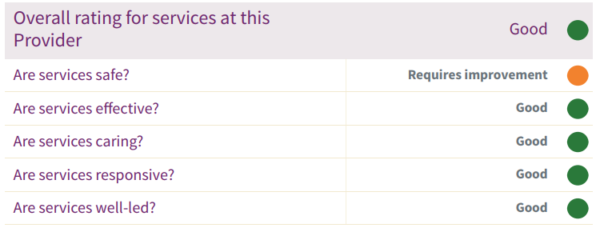
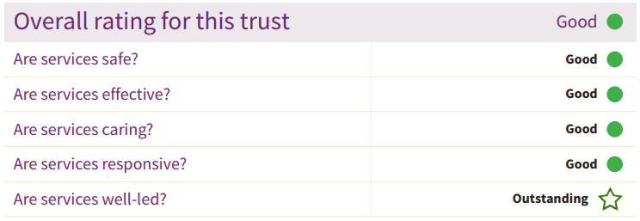
CQC Inspection Results
June 2017
April 2019
Leadership is everyone – not just the executive team……..

Slide 51

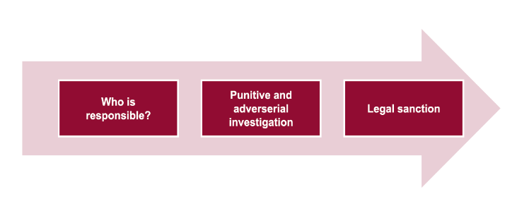
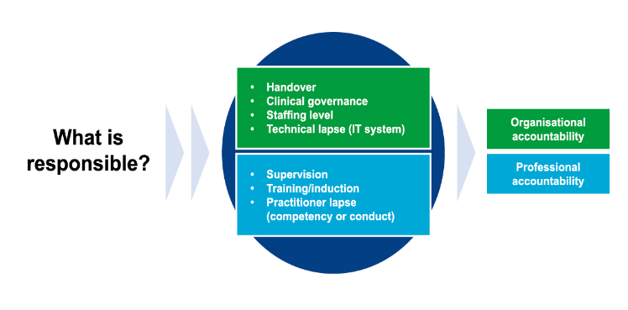
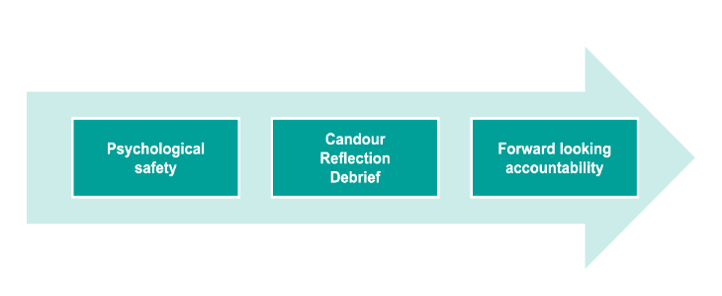
Systematising change
Just and Learning: Distinguishing
causality versus contribution

Slide 52
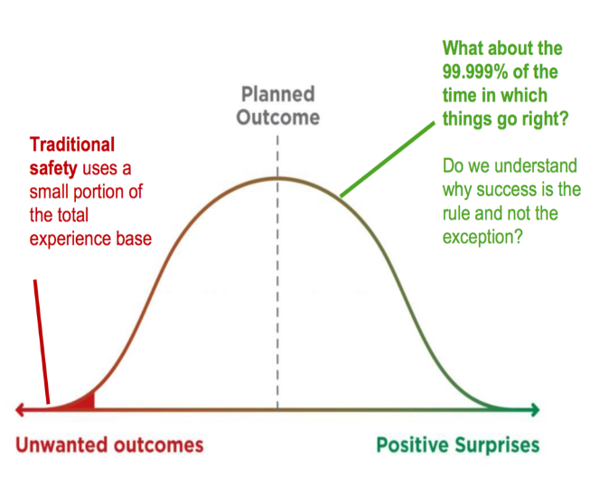
Systematising Change -
Learning from the every day routine,
not just incidents

Slide 53
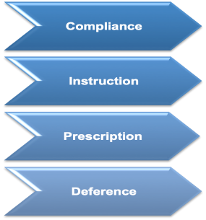
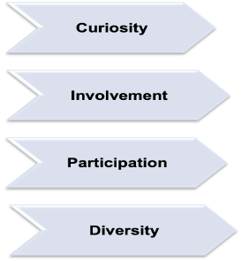
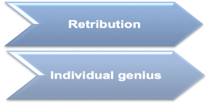
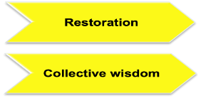
We are shifting our safety mindset
Safety 1
Safety 2
Isolated individuals cannot translate excellent across an organisation – we need to move to collective wisdom and gain a better safety dividend?

Slide 54

What’s your business case?
What’s your burning platform for your organisation?
Feedback from room – we do have burning platforms in our ambulance work, just look at our staff survey results and our sickness and staff rates.
Our mirrors were staff relations and patient suicide rates.
Our mirrors were staff relations and patient suicide rates.

Slide 55
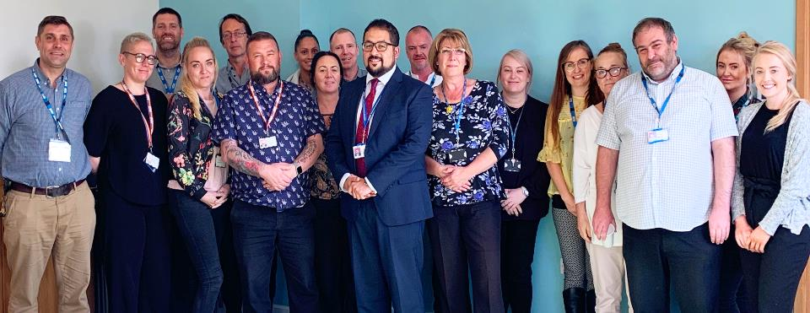
Learning review following a homicide
The staff said…
“they felt its was a safe place to reflect, ask questions and really think about our practices”

Slide 56

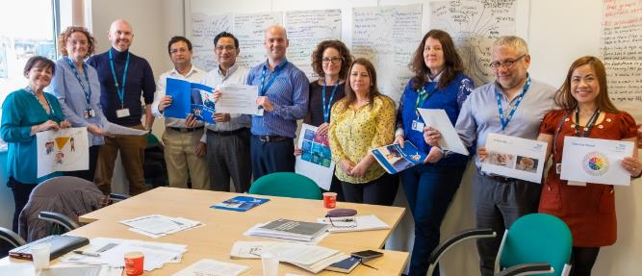
Just and Learning Culture
Respect & Civility Work Stream

Slide 57

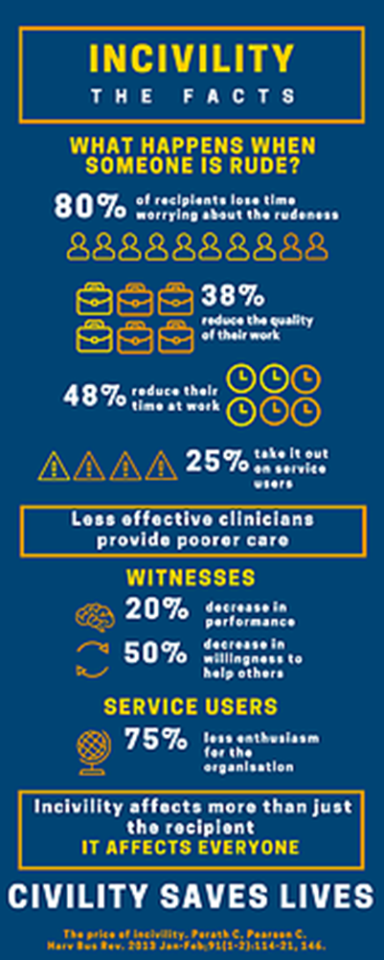
Notes:
The facts speak for themselves
Dr Chris Turner and others have established a strong campaign that civility saves lives #civilitysaveslives.
There’s clear research from the British Psychological Society that shows teams of friendly, focussed colleagues deliver better outcomes for their patients. When someone’s rude to a colleague.
We have now produced our own info graphic to demonstrate this…

Slide 58
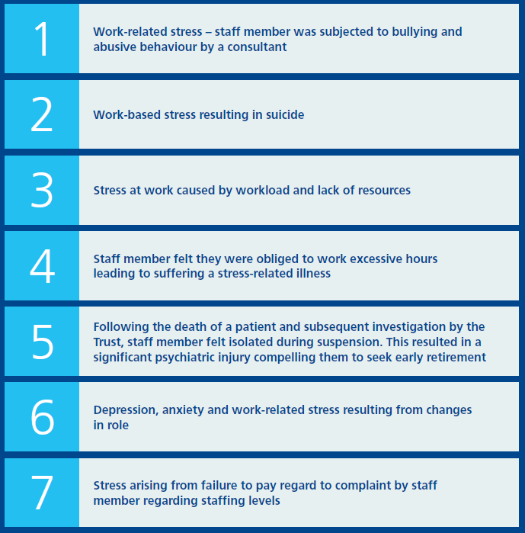
Description of harm in claims 2014-2019;
NHS Resolution

Slide 59

Bystander
I WILL SPEAK UP!
Perceived Bully
Perceived Victim
Notes:
Can we have a round of applause for our actors please and can they please stand up.
For those of you that aren’t aware our two actors have been prepped and versed to have a few confrontations throughout the day, which evident poor leadership a lack of civility and disrespectful behaviour which we know is not acceptable in the workplace.
The purpose behind us planting our colleagues into today’s meeting was to understand how many of yours leaders spoke up and challenged or maybe you didn’t!
I’m not asking any of you to embarrass yourselves and ask you why you didn’t intervene but I do need to ensure that you are aware of the accountability of the bystander who has a duty of care not only to patients but to fellow colleagues also. You may not be on the receiving end of poor behaviours but if you are exposed to these there is a culpability and responsibility for you to speak up. Which is why we are launching our I will speak up campaign.
Call to action - #IWILLSPEAKUP ask the Leadership Forum to start using the prompts today #IWILLSPEAKUP and download and use moving forward. Put it in your next team meeting agenda.

Slide 60
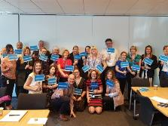
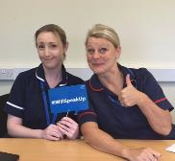



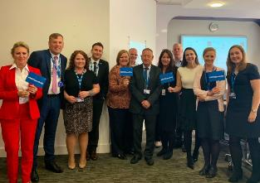
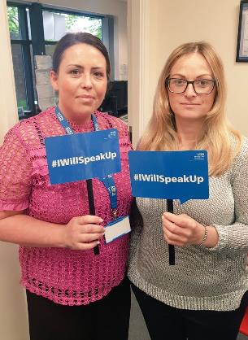
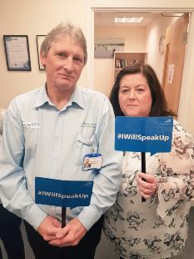
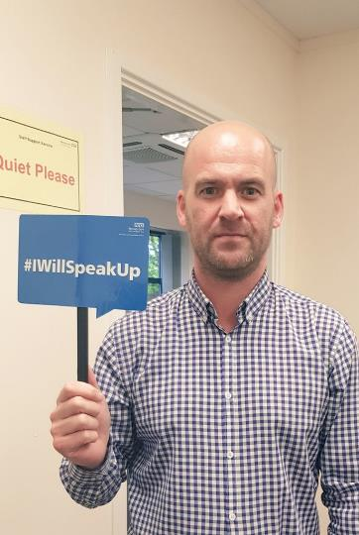


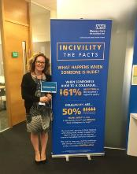




Slide 61

Challenging behaviour and mind-sets; empowering our people #IWillSpeakUp

Slide 62
Respect and Civility Jigsaw
‘Developing a tool/framework, aligned to our organisational values that fosters and supports civility in practice.’

Slide 63


Slide 64


Slide 65



Module 1 - A New Way of Caring https://www.merseycare.nhs.uk/justandlearning/story_html5.html?lms=1
Module 2 - A Guide to HR Practice
https://www.merseycare.nhs.uk/justandlearning2/story_html5.html?lms=1
Implementing a Just and Learning Culture
A Guide to HR Practice
Northumbria University 4 day Restorative Culture Training
https://www.northumbria.ac.uk/study-at-northumbria/continuing-professional-development-short-courses-specialist-training/restorative-just-culture/
Module 3 – coming soon!
Notes:
Add links

Slide 66



Impact of the programme

Slide 67

Summary
We have focused on concept into practice
Underpin with operational excellence and support
But…halt judgments and instead ask why people behave in the way that they do
See transparency and openness as allies not enemies
Culture that allows the boss to hear bad news
Co-produced approach with staff side and patients/users
Moving to learning from our routine work
Understand the distinction between resources and resourcefulness – the latter can take you a long way
See your people as the solution and not the problem
Sharing your vulnerability
Leave the rule book to the right – remember you are a person.
Create a culture were people have a voice.

Slide 68

Thank you
Amanda.oates@merseycare.nhs.uk
@amandajoyoates
www.merseycare.nhs.uk
Mersey Care NHS Foundation Trust
V7 Building
Kings Business Park, Prescot
L34 1PJ
Telephone: 0151 473 2757
Just Culture The Movie
https://www.youtube.com/watch?v=LCFcvekVWGM&feature=youtu.be

Slide 69

Tea time
Please be back by 11:50

Slide 70
Our Culture for Delivering High Quality Care
Simon Nearney
Director of Workforce &OD
Myles Howell
Director of Communications
& Employee Engagement

Slide 72


Slide 73


Slide 74
Where we started 2014/2015
Worst performing ED in the country
Cancer targets not being met
RTT not being met
CQC rating of ‘requires improvement’
An interim Chief Executive and an absent Chairman
Significant staff disengagement (worst rating in England)
A culture of bullying and inappropriate behaviour
Urgent care being delivered from temporary buildings and only 7/14 ED consultants in post
Low nurse establishments on many wards
Media coverage relentlessly negative and often staff driven
We were not in a good place and we had to be honest about where we found ourselves

Slide 75
Acknowledge there is a problem
CQC report described bullying culture
Staff survey corroborated these findings but had not been acted upon
Trade unions had struggled to be heard for some time
Decided to involve ACAS…
We needed to put our people first…….we had to ‘blow it open’.
We had to be open and apologise that we had got it wrong.

Slide 76

Establish a baseline culture
Barrett survey 2014/15
We smashed it out of the park with 10 limiting values – we were that bad!!

Slide 77


In five words, how would your staff describe the current culture?
We’d like you to hold these thoughts – What are our strengths? What do we really need to tackle? Bring your thoughts and conversations to the discussions you want to have this afternoon.

Slide 78
Initial Action
Recruited new Chief Executive, Chairman and to other Board roles
Publicly acknowledged the Trust had a significant problem / staff had been let down / things were going to change
Formed a working group in partnership with our trade unions. Joint commitment to address the issues identified
Staff at all levels were involved
Chief Executive-led
Developed a 10 point plan
Appointed a champion – Anti Bullying Tsar
Zero tolerance

Slide 79


Set clear vision and values
We deliberately put staff first – we knew that great care would follow.

Slide 80

Embed the values
In our induction we don’t talk about policies and procedures, we talk about our staff charter.
  Established a staff charter based on our values and recruited for values as well as competencies
  Adopted a values based approach to recruitment
  Developed our Professional and Cultural Training programme for all staff (PACT)
  Discuss values and behaviours at every Trust induction, rather than HR issues, security and car parking (!)
Notes:
Established a staff charter based on our values and recruited for values as well as competencies
Adopted a values based approach to recruitment
Developed our Professional and Cultural Training programme for all staff (PACT)
Discuss values and behaviours at every Trust induction, rather than HR issues, security and car parking (!)

Slide 81
Encourage reporting
Established a confidential staff advice line service (SALS), run by our PALS team
Board to ward
Freedom to Speak up Guardian (board lead)
Anti-bullying Tsar
Line managers
HR, Trade Unions, Occupational Health
Counselling service
Data collected and presented at the working group. All issues were discussed and addressed.

Slide 82
Focus on leadership and employment framework
  Communicated values to our senior managers
  Held annual senior manager culture sessions to remind them that they are responsible for creating the right environment for their teams
  Addressed leadership development at all levels
  Great Leaders programme – Be Remarkable
  Reviewed and re-launched:
    Bullying and Harassment policy
    Managing and Supporting Attendance policy
    Disciplinary policy
    Grievance policy
    Whistleblowing policy
We make no apologies for actively talking about what it means to be a leader in our organisation

Slide 83

Developed our brand around our people – why not a bit of humour?
It’s alright to have fun and enjoy yourself at work
Notes:
Key priority - filling ALL vacancies!
Re-branded the Trust ‘Remarkable People, Extraordinary Place’
Invested in creative advertising
Moved on to retention and creating the Best Place to Work

Slide 84


Slide 85

Adopt a clear measurement –
Staff engagement
Notes:
National Staff Survey uses nine questions to measure staff engagement
Starting point was 3.54 (out of 5) (6.4/10)
We measure this quarterly – staff FFT
The system we have created with Capita enables us to receive engagement scores at ward/dept level (where 10+ staff have returned a survey)
Positioned culture alongside quality, performance and finance, in QTRLY performance meetings

Slide 86

Cultural assessment –
Barrett Survey 2017
We have improved but there is always more to do….

Slide 87
Our conversations have shifted ….
2018/2019
Engagement 7/10
Professionalism
Respect
Improvement
Compassion
Excellence
Leadership
High quality care
2014/2015
Engagement 6.4/10
Bullying
Nepotism
Dishonesty
Fear
Control
Investigations
Notes:
The conversation has changed

Slide 88


CQC report 2015

Slide 89



CQC
report 2018

Slide 90














Notes:
A real focus on health and wellbeing

Slide 91


Slide 92

Table reflections on what we’ve heard this morning
What surprised you?
Is there anything that’s missing?
Senior leaders are human we all have vulnerability yet how often do we show it? Vulnerability in leadership is a strength not a weakness
How do we balance performance vis a vis our human side of looking after each other? We need to redress this and get the balance.
Using the language of healing – our AACE CEOs have to be on-board with this and allow it to happen throughout the organisation.

Slide 93



Task for the room : create an agenda for the afternoon
Kathryn asked that the room reflect on the three presentations they had heard and have a discussion at their tables. In particular to
Discuss ideas for topics to explore in the afternoon
On each table there are A5 Unconference sheets
To write a short sentence that describes a discussion topic on the A5 unconference sheets
Hand in the A5 sheet to the front of the room
Over lunch a number of people in the room helped to theme the various unconference sheets into a number of discussions

Slide 94
Our afternoon session
Kathryn reminded the room about what we wanted to achieve for the afternoon:
Discuss our desired future for culture and leadership in the Ambulance Services
Challenge, endorse and enhance each other’s ideas
Commit to individual and collective action
Create a “snowstorm” of feedback

Slide 95



Moving to unconference
“The sum of the expertise of the people in the audience is greater than the sum of expertise of the people on stage”
Dave Winer
Source of image: www.citynet.com
The Law of Two Feet:
“ If you find yourself in a situation where you are not contributing or learning, move somewhere where you can. ”

Slide 96
Our topics
Table | Topic | Table | Topic
1 | A more inclusive culture: practical steps to make it happen | 6 | How do we “free-up” our people to do this work?
2 | Walking the walk right across an organisation | 7 | From reprimand to compassion: how do we make it happen?
3 | Playing the long game: how to sustain culture change when we know it’s slow | 8 | Role-modelling by senior leadership
4 | “Leadership development”: how to move to a different model | 9 | Our language impacts our mindsets: how do we shift it?
5 | Moving on from performance and targets: where to start? | 10 | Sharing our knowledge: how do we do this more effectively?
#AmbCulture
Notes:
This table will be populated from popular themes from the morning

Slide 97

Our feedback from the unconference
Table | Topic
1 | An Inclusive Culture - Reverse mentoring is a great big idea. We all have blind spots and especially in leadership. Have conversations with people who are different to you – female, BAME etc – massive learning piece for our organisations.
2 | Walking the walk - Parity of esteem and respect of wherever you work – we all have important roles be it frontline or support services. Lets reduce physical barriers between our services – no more of the two rest room culture. We want positive role models from our young people – not the sticky middle who may be disillusioned or not want to change. We do though have a significant lack of investment in our middle leaders.
3 | Sustaining culture change - We need to keep people engaged and keep patients involved in our change through a golden thread of consistency. Without sustainability around a programme of culture change people will leave. We need to make people welcome and involved and it be safe to speak. Consistent leadership and humility – build your movement and accept that the change will take time. Let the staff design the measures of culture shift – they co-create us and own the culture.
4 | Leadership development - Assumption that good clinicians make a good manager – why? We must put the development in place. Evidence of CPD based around leadership is essential and we need to give the leaders time to develop a different way of doing things. A model of national CPD for ambulance leaders would be of benefit. We await with interest the proposed NHS leadership compact.
5 | Moving on from performance targets - We cant leave targets but we must shift from just focusing on our performance numbers to our people (safe environments for staff). We must all (including boards) focus on the human aspect – happy people will mean better performance eventually. We need to question league tables and the importance thereof. How do we mobilise best practice to bring this into focus. Our change will be reflected in language – the first things on our minds should ‘how are you?’ and a shift to co production.
Notes:
This table will be populated from popular themes from the morning

Slide 98

Our feedback from the unconference
Table | Topic
6 | Freeing up our people - We must make time for our staff and value their mental health. It is essential that we start to create the time. Do not allow the cynicism to push us backwards on such an initiative. ? We must get our boards and external stakeholders in to this mindset – there may be a hit on performance as a result. Find the money and resource to do properly – retention, staff surveys, attendance at events etc. All CEOs to be signed up but also take that hit on performance – long term it will be better.
7 | From reprimand to compassion - We want to keep our people – retention – reduce the scary words and constant hard expectation. There needs to be consistency and a move from hurt to healing for all our staff. We need to learn from what is happening elsewhere and be open to it. We need to be less punitive – why do we always blame and discipline especially as this is a service where often we have to react. Allow flexibility and do things differently and actively encourage a balance between support and performance. Perhaps we develop training, well received campaigns and even a framework that can stimulate thought and leadership.
8 | Role modelling by senior leadership - We need a genuine and authentic commitment to deliver a more compassionate leadership throughout our organisations. We need to increase our focus on becoming role models, commit to it and deliver. Let the organisation know this will take a while but then demonstrate that investment is being made and the benefit sought.
9 | The language we use - Shifting our language can help build trust and sets expectations of what is right for all. Encourage healthy conversations – break the habit. Discussion should not just be about KPIs. Bring people along not tell them. Why do we use such hard language – serious, incident etc? We need our people to talk to us when things are not going right. We all need freedom to speak up – hoe do we support managers to step into this space?
10 | Sharing our practice - No participants
Notes:
This table will be populated from popular themes from the morning

Slide 99
Our big ideas
Table | Topic | Table | Topic
1 | Inclusive culture, practical steps to make it happen: Reverse mentoring | 6 | How do we free up our people to do this work? Get every CEO signed up to an approach that allows people to have time for each other. Understand that performance will have a hit.
2 | Walking the walk across the organisation Link into themes – Reverse mentoring and shifting our language. | 7 | Moving from reprimand to a compassionate culture Develop a framework with principles of how the shift can be achieved in ambulance services.
3 | Playing the long game – how to sustain culture change when we know it slow: Staff define the measures that are important to them and we use these to track our progress | 8 | Role modelling by senior leadership: Authentic and real commitment to deliver.
4 | Leadership development – how to move to a different model: Develop a national model of CPD for ambulance leaders | 9 | Shifting our language: Encourage managers to take the power they have and equip them to change their language. Ensure that they are supported through both formal training and by tacit support from all senior leaders.
5 | Moving on from performance and targets: Be led from the top and ensure that it is linked into the change in language. | 10 | Sharing our practice - No table work completed.
Notes:
This table will be populated from popular themes from the morning

Slide 100


Moving to Actions – Kathryn asked that people re-group into their ‘real world’ teams to give thought to:
What’s needed as a team or organisation?
What’s needed at a national level?

Slide 101
Our feedback – moving to action
As a team/organisation
At a national level
Celebrate our success; involve everyone, actively listen; back to the floor programme for managers; network more; embrace story telling; make our work visceral and visual; involve people
Appoint a national lead for our culture work; talk more; meet; collaborate; articulate and be consistent in our aims; work together to develop our appetite for change; be the change we want to be.
What could we speed up / do more of ? (Accelerate)
Stop the blame language; don’t interpret policies in black and white text, they are guides; stop blaming performance as a barrier to change; stop focusing on just numbers; stop short termism; stop the silos.
Stop the blame and hurt language; stop the demanding targets; stop competing across our services; stop the short termism – this is a long haul; stop ignoring difficult conversations as we need to be better.
What could we stop doing ? (Brake)
Facilitation skills for managers; make the time for change; reverse mentoring; define and review our purpose; engage all functions; develop our ambulance culture plan to the NHS people plan; staff focus groups; employee conversation cafes.
Move to ‘Just Culture’ leadership development; develop a framework with accepted principles; cross organisational working; share practice and discuss; invest some money to make this change happen
What could we start doing? (Create)
Lets have fun and be positive that we can affect the change we all want to see.
Other ideas / actions:
Adapted from www.idenk.com

Slide 102

Snowstorm
We ended the day with a snowstorm of feedback
One insight from today:
We are our peer group – more collaboration, less competition
Just coming together today is really important
Positive role modelling needs to be built into programmes and approach
Happy staff are productive and effective
CEO commitment to culture change is key
Change the language
Compassion for staff enables compassion for patients
AACE should adopt a ‘just culture’ framework [popular idea]
Not allowing failure to be the driver of change
On a sheet of paper, write down one insight from today that we must not lose.
Turn over the sheet. On the other side, write down one big idea for transforming culture and leadership in the Ambulance Services.
Screw up the paper.
On the signal, throw it in the air towards another table.
One big idea:
Reverse mentoring [most popular idea]
Heal don’t harm [second most popular idea]
“Change is possible and it starts with me.”
It’s okay to have fun while working
It starts with the Board
More voice from the frontline into the room, please
Don’t give up the faith in what we do
More sharing best practice
“We must be mindful to promote healing when our staff are hurt and not cause more hurt through our processes”
Stop competing, start collaborating, share our successes
“We take care of you, so you can take care of them” Simon and Myles
“Performance and culture are not mutually exclusive. By enabling a positive change in culture, performance and patient care are positively affected.”

Slide 103



Final Reflections
Kim Tovey – Welsh Ambulance Services
We need to move towards a culture that heals
Emma Saunders – South East Coast Ambulance Services
We need to get out more, collaborate and share what we do

Slide 104

Next steps – Claus Madsen – Chair of CALNAS
Change our language to one that heals
CEOs must sign up in allowing time for people (including operational staff) to have time for each other and shape this work
Get the system to understand that this shift will take time
Shift from performance only conversations
Recognise the interconnectedness of work in making a difference to the whole – local OD, diversity, #ProjectA
Support our middle managers better – sandwiched between the human and performance
 | Potential “action” areas for CALNAS to take forward
1 | Determine a national sponsor for the culture change work. This should be at CEO level and linked into AACE. Note, Helen Ray (NEAS) has offered to undertake this role.
2 | Develop a response to the NHS People Plan (Core Offer and Leadership Compact) – an ambulance people plan.
3 | Moving from reprimand to compassion – develop a national framework for ambulance services, highlighting principles and practice.
4 | Develop and provide the opportunities for people to meet, discuss and collaborate more – learning from each other and mutual support in making the change happen. Facilitate the energy needed for this and build the movement for improving culture.
5 | Develop a national model of CPD for ambulance managers.
6 | Facilitate the introduction of reverse mentoring across all ambulance services
7 | Develop a national leadership development programme for ambulance services – supporting managers beyond clinical and technical competence.
8 | Co create with operational staff the measures that matter to them in respect of good organisation (and culture).

Slide 105



Appendix 1 – Unconference Outcomes

Slide 106



Appendix 1(a) – Unconference Outcomes

Slide 107



Appendix 1(b) – Unconference Outcomes

